Slide 1
Data Analysis on League of Legends for Champion Selection
Zixiao Wang

Slide 2
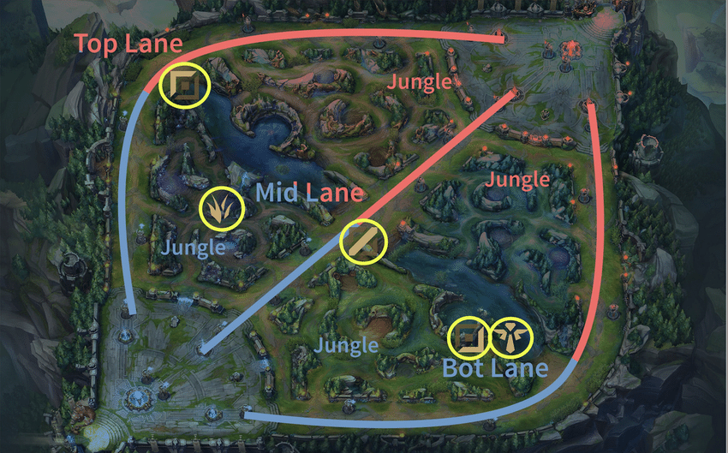
Introduction
The players compete in teams of five
Each champion has 4 unique skills
168 champion in total
more than 130 million monthly players
$6,450,000 prize for Champion of every year’s final tournament

Slide 3
Goal
The game is highly dynamic based on champion selection with corresponding position selection at the beginning of the game. This project focuses on the design and development of a data processing structure to create a scalable recommendation system to optimize champion selection
TOOLs: Spark, Panda, Matlab, Spark.ML library, RiotWatcher

Slide 4
Data Collection and Cleaning Pipeline
Official API key to request DATA from official game server. (Limit 100 requests per min per API)
No available direct request for match data
Use Diamond Division Players (Top 4% in NA) data to pull matchID they participated in
Pull match data from server with API (one per Developer account, expires in 24 HRs)
removing redundant items and selecting data such as Champion selected, items bought, and banned champions
Store data in CSV:
summID
PUUIDs
matchID
championData
champion_withLost_Data

Slide 5
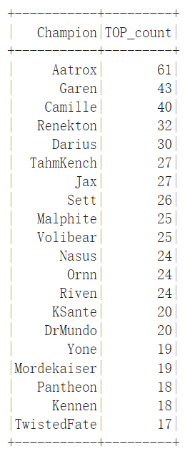
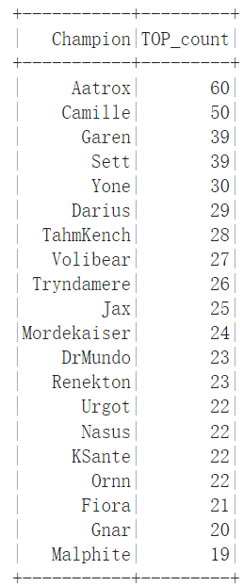
Analysis of win rate for each position
Most number win is not working
Win rate is better choice
left(win count)
right(lose count)

Slide 6
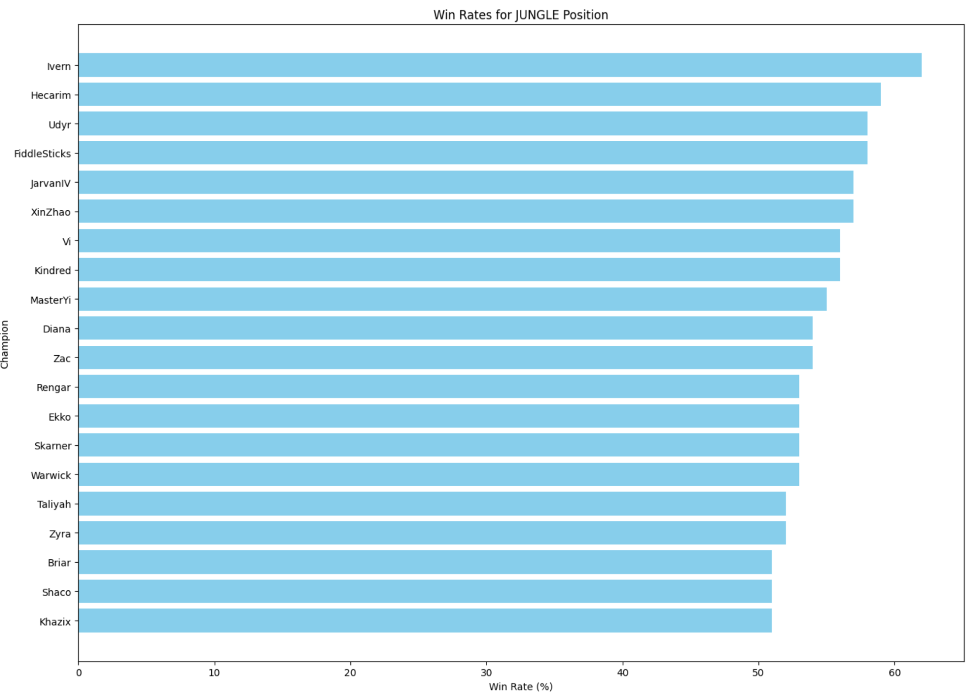
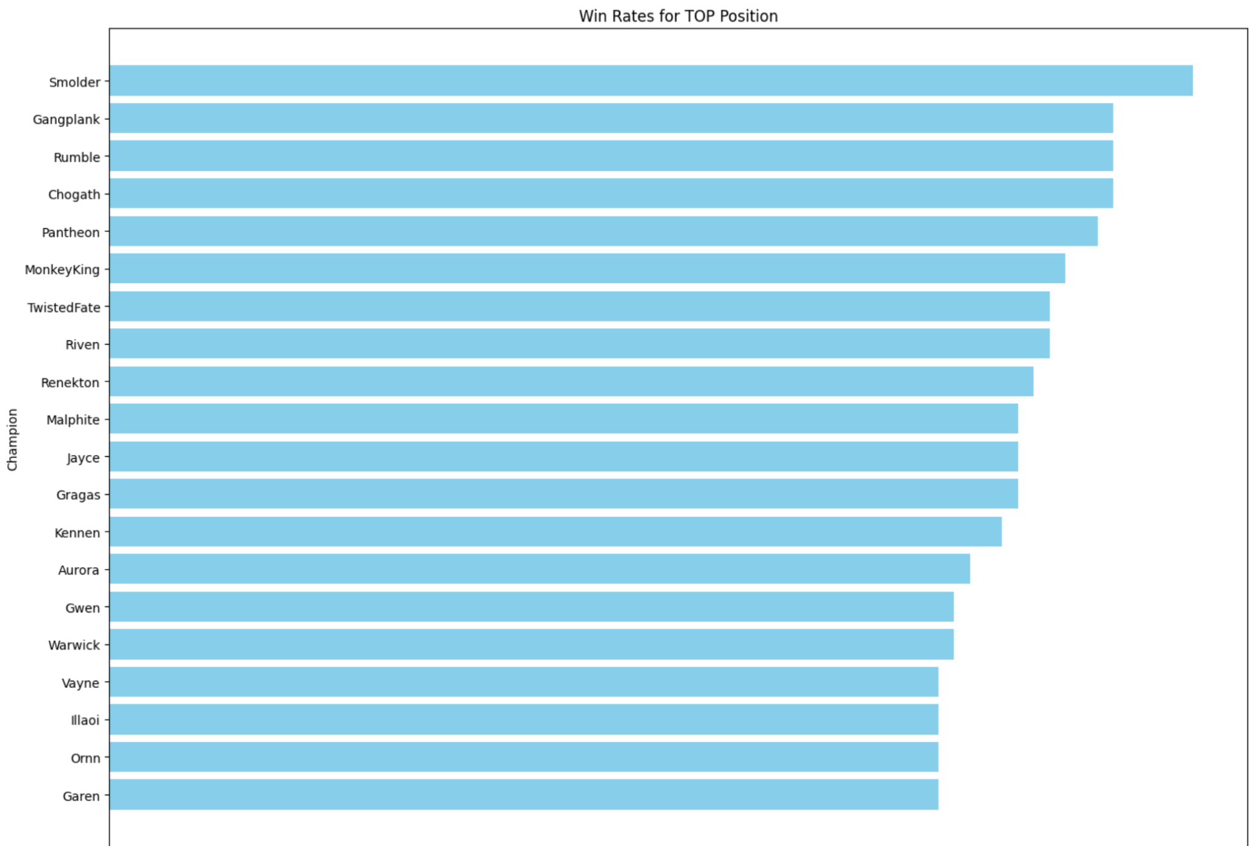
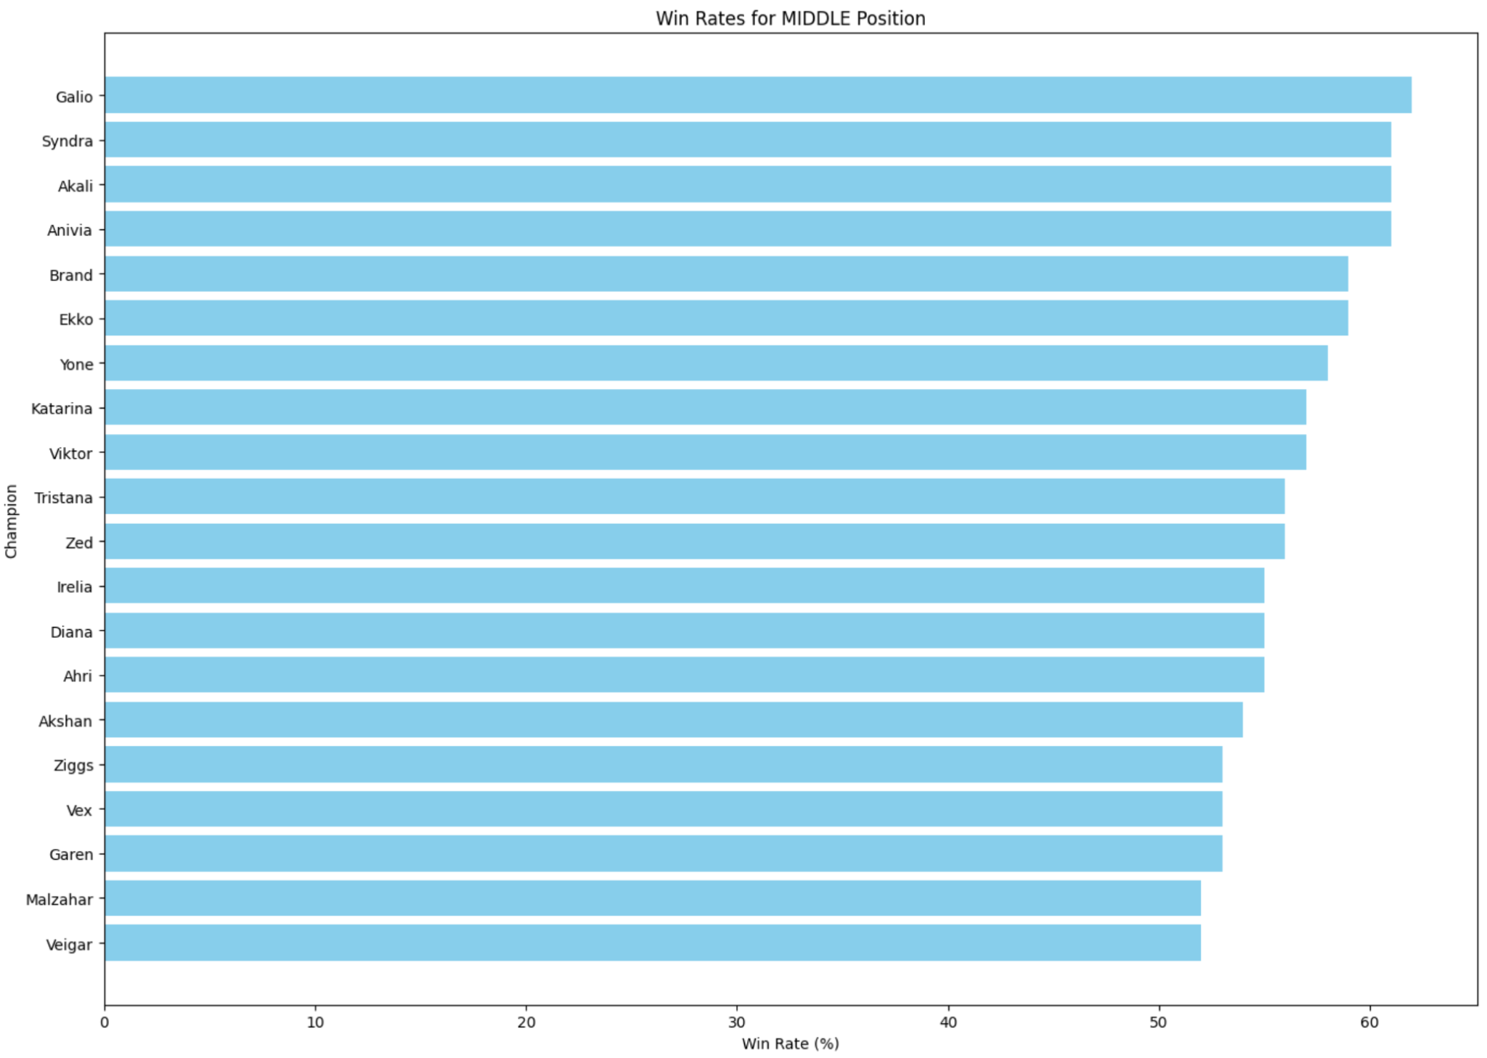
Win rate visualization

Slide 7
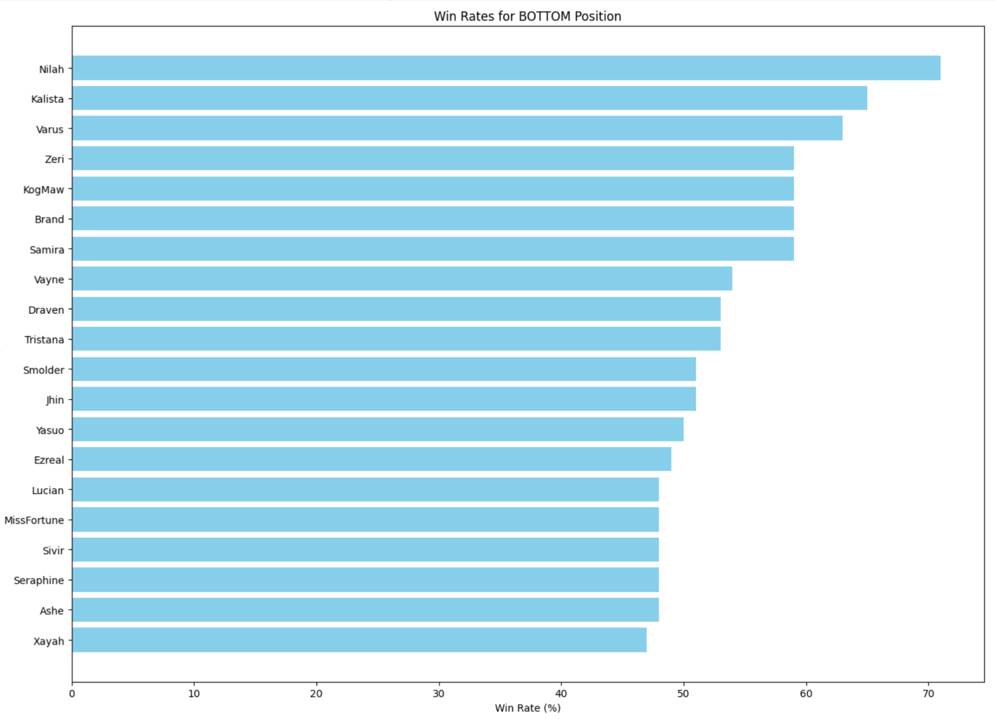
Win rate visualization

Slide 8
Win pattern
BOT graph are called mid-late game champions by players, who tend to be weak in the early game, while SUP graph suggests some champions labeled as powerfully supportive
TOP, MID, and JUG graphs favorite champions who are extremely aggressive in the early game.
The pattern is about winning the early game with aggressive TOP, JUG, and MID to ensure BOT and SUP can end the game in the middle stage of the game.

Slide 9
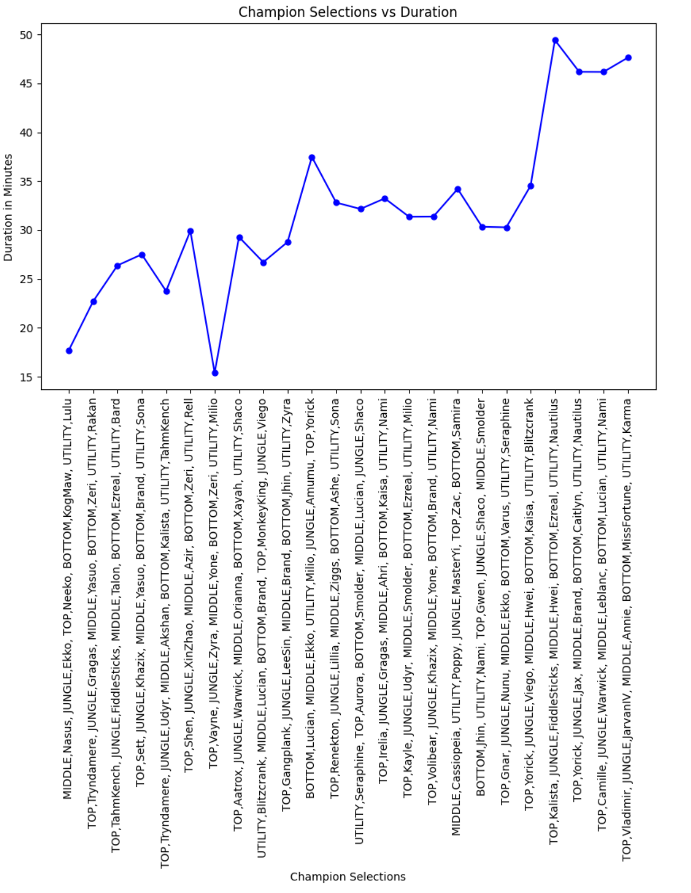
Duration of game with Time Composition
The analysis is segmented into 15-minute intervals, up to 60 minutes, as most games conclude within this time frame.
The graph further validates the specific winning patterns discussed earlier in this report, highlighting a critical trend: most games are won around the 30-minute mark

Slide 10
Team Composition and Game Duration Model
The model's performance is evaluated using the Root Mean Squared Error (RMSE). The model yielded an RMSE of 14.739
only 1,000 matches were analyzed and countless possible combinations of five champions from a pool of 168
due to the limitations of the Riot Server, it was assumed that 1,000 matches would provide sufficient data. However, the results indicate that a much larger dataset is necessary to achieve more accurate predictions

Slide 11
Top Lane Win Rate Prediction Model
This model is evaluated with RMSE, 7.7652. The RMSE still appears less than ideal, but better than previous one
huge improvement as the complexity is reduced from predicting with five champions to just one

Slide 12
Summary of Model Evaluation
The significant improvement of Top Lane Win Rate Model underscores the effectiveness of the infrastructure and pipeline, demonstrating that they are functioning as intended. Further enhancements can be readily achieved by incorporating more match data into the pipeline, which will help refine the model and yield more accurate results.

Slide 13
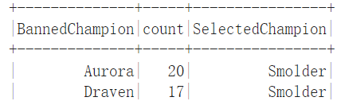
Potential User Case
As a player, first to choose a position to play in the game. Through the data analysis portion of the structure, the player notices certain champions he can play with a high win rate. Then he further checks the champions he needs to ban to get more advantages in the gameplay.
Then use the model to input the team composition to see whether the team can win in early-stage or mid-stage, even late-stage games. According to that, set up appropriate strategy through out the game.

Slide 14
Thank You For Listening
Questions?

